Slide 1
Bellwork
Day 1- ?
Create links to specific slides by copying URL when viewing slide (each page has its own)
Try a todaysmeet linkk permanently on side board with daily reminder to community time notes.
Notes:
Testing presenters mode notes

Slide 2
Bellwork
What is the difference between solute and solvent? Which is in the greatest quantity?
List several solution examples identifying the solute and solvent (challenge: include one non-liquid solution example)

Slide 3

Complete equation, balance, and identify the precipitate on #3:
__ Li₂CO₃ (aq) + __ BaBr₂ (aq)
__ C₄H₈ + __ O₂
Answers - reactions & stoich bellwork

Slide 4
CuCl₂ + 2NaNO₃ Cu(NO₃)₂ + 2NaCl
If 19.8 g NaCl are actually produced in the lab using 24.3 g CuCl₂, what is the percent yield?
Answers - reactions & stoich bellwork

Slide 6
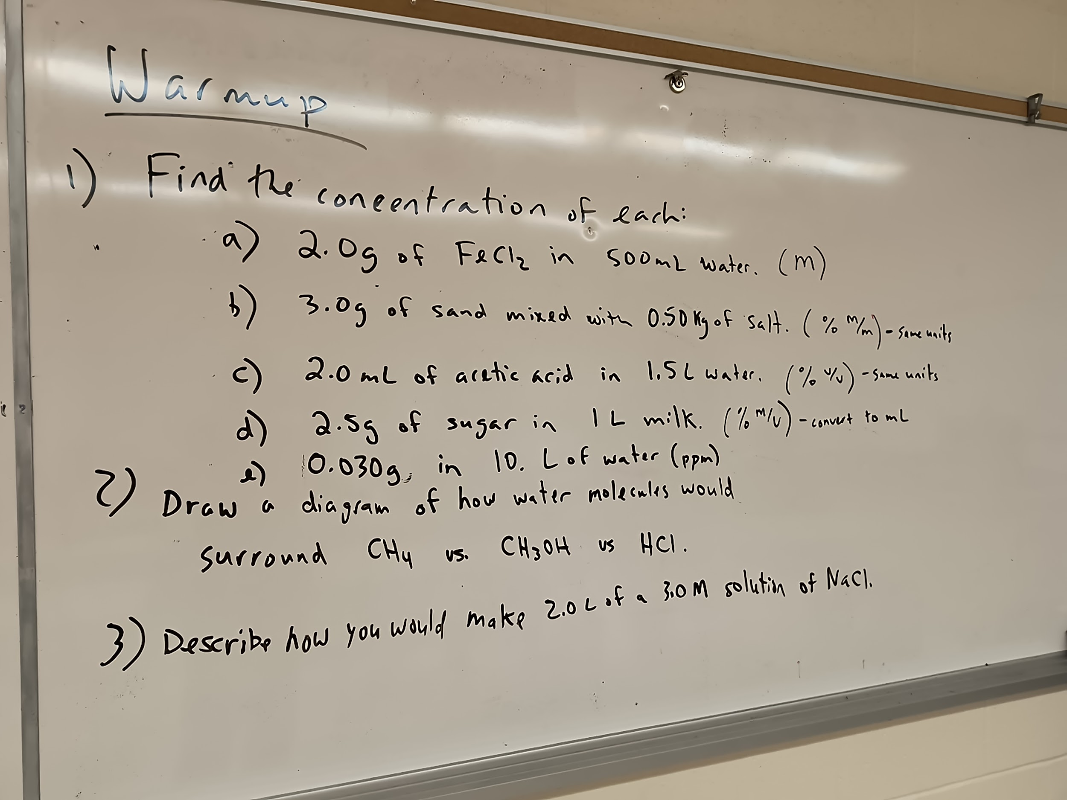

Slide 7
Answers - reactions & stoich bellwork
Fe + O₂ Fe₂O₃
Write and balance the equation above.
If 16.4 g Fe react with excess oxygen, how many grams of iron (III) oxide should be produced?
If, at the end of the experiment, 15.7 grams of iron (III) oxide were actually produced, what is the percent yield?

Slide 8
__ LiOH + __ H₂CO₃ __ Li₂CO₃ + __ H₂O (unbalanced)
Balance the chemical equation above. Then determine how many moles of LiOH are required to react with 20.0 mol H₂CO₃?
Answers - reactions & stoich bellwork p2

Slide 9
Using the activity series, predict whether the following reactions will or will not occur.
Ni & H₂O
Br₂ & KI
Cr & H₂ O
Answers - reactions & stoich bellwork p2

Slide 10
Give the type of chemical reaction for the following. Complete & balance—Then identify the precipitate in the product.
(NH₄)₂SO₄ (aq) + Ba(NO₃)₂ (aq)
Answers - reactions & stoich bellwork p2

Slide 11
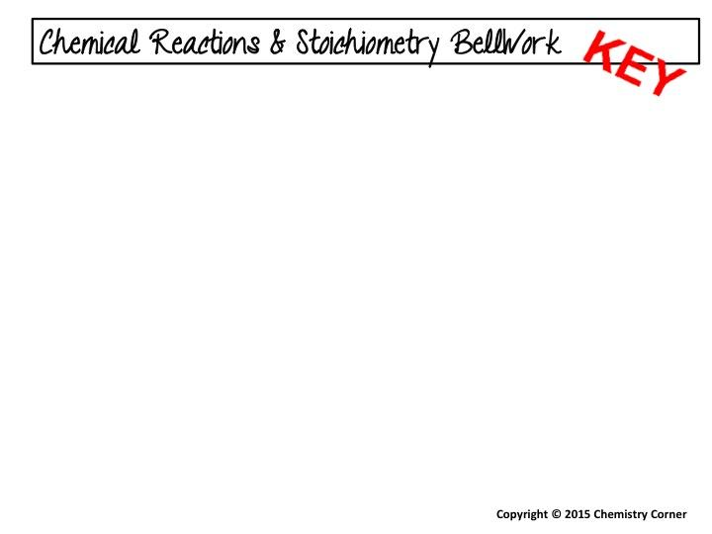
P₄O₁₀ + 6 H₂O 4 H₃PO₄
2 C₈H₁₈ + 25 O₂ 16 CO₂ + 18 H₂O
Li₂CO₃ (aq) + BaBr₂ (aq) 2 LiBr (aq) + BaCO₃
C₄H₈ + 6 O₂ 4 CO₂ + 4 H₂O
single replacement,
Zn + AuNO₃ Zn(NO₃)₂ + Au
Yes, will occur—using the activity series,
zinc will replace gold.
93.8%
4 Fe + 3 O₂ 2 Fe₂O₃
23.4 g Fe₂O₃
67.1%

Slide 12
__Al₂(SO₄)₃ + 3 Ca(OH)₂ 2 Al(OH)₃ + 3 CaSO₄
2 NH₄Cl + Ca(OH)₂ CaCl₂ + 2 NH₃ + 2 H₂O
2 LiOH + H₂CO₃ Li₂CO₃ + 2 H₂O 40.0 mol LiOH
120 g NaOH
49.7 L H₂
will not occur
will occur
reacts with steam, but not cold water
double replacement,
(NH₄)₂SO₄(aq) + Ba(NO₃)₂(aq) 2 NH₄NO₃(aq) + BaSO₄
13.2 g H₂
36.0 L N₂
44.5 g CaCl₂
94.3%

Slide 13
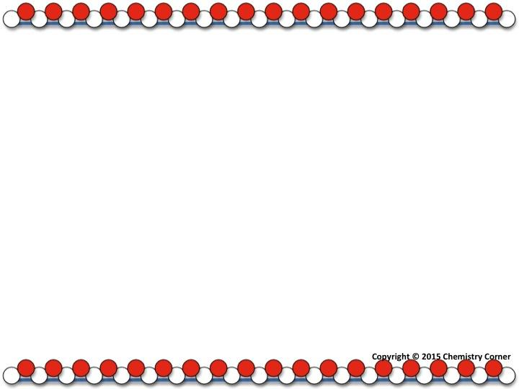
How many moles of NaCl are contained in 250.0 mL of a solution with a concentration of 1.25 M?
Answers - Solutions

Slide 14
How many grams of KCl are needed to prepare 0.750 L of a 1.50 M solution?
Answers - Solutions

Slide 15
List any of the following that are homogeneous mixtures:
water
sugar
coffee
sand
an aqueous KNO₃ solution
a sugar-water solution
whole wheat bread
a pitcher of Kool-Aid
Answers - Solutions

Slide 16
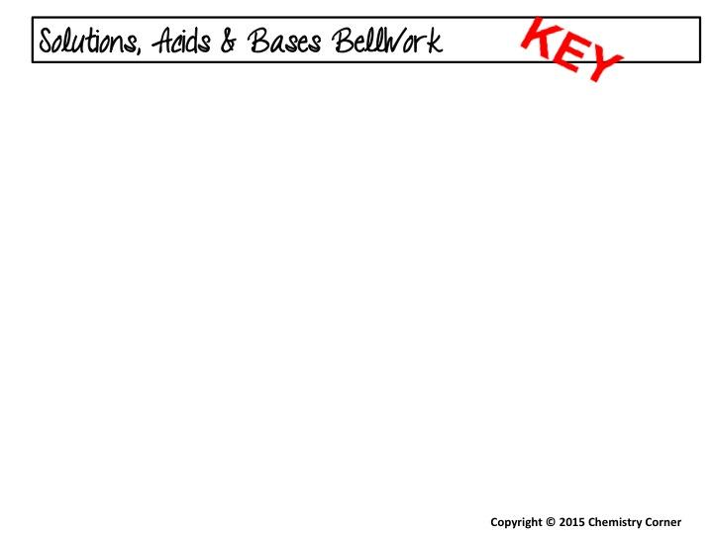
0.313 mol NaCl
83.9 g KCl
4.00 M
salt and water
3 Sr(OH)₂ + 2 H₃PO₄ Sr₃(PO₄)₂ + 6 H₂O
salt = strontium phosphate
acid
base
acid
acid
base
aqueous KNO₃, coffee, sugar-water, Kool=Aid

Slide 17
Notes:
Day 1

Slide 18
Bellwork -
Tell on your classmates (or yourself): Cool stuff, great accomplishments (or small ones), epic fails (or small ones), fun quotes etc - Post them to the side board!!

Slide 19
Bellwork

Slide 20
Bellwork

Slide 21
Bellwork

Slide 22
Bellwork

Slide 23
Bellwork
1
Notes:
Day 1

Slide 24
Bellwork

Slide 25
Bellwork

Slide 26
Bellwork

Slide 27
Bellwork

Slide 28
Bellwork
hgfre

Slide 29
Notes:
Day 1

Slide 30
Bellwork -
Tell on your classmates (or yourself): Cool stuff, great accomplishments (or small ones), epic fails (or small ones), fun quotes etc - Post them to the side board!!

Slide 31
Bellwork

Slide 32
Bellwork

Slide 33
Bellwork

Slide 34
Bellwork

Slide 35
Bellwork
1
Notes:
Day 1

Slide 36
Bellwork

Slide 37
Bellwork

Slide 38
Bellwork

Slide 39
Bellwork

Slide 40
Bellwork

Slide 41
Notes:
Day 1

Slide 42
Bellwork -
Tell on your classmates (or yourself): Cool stuff, great accomplishments (or small ones), epic fails (or small ones), fun quotes etc - Post them to the side board!!

Slide 43
Bellwork

Slide 44
Bellwork

Slide 45
Bellwork

Slide 46
Bellwork

Slide 47
Bellwork
1
Notes:
Day 1

Slide 48
Bellwork

Slide 49
Bellwork

Slide 50
Bellwork

Slide 51
Bellwork

Slide 52
Bellwork

Slide 53
Notes:
Day 1

Slide 54
Bellwork -
Tell on your classmates (or yourself): Cool stuff, great accomplishments (or small ones), epic fails (or small ones), fun quotes etc - Post them to the side board!!

Slide 55
Bellwork

Slide 56
Bellwork

Slide 57
Bellwork

Slide 58
Bellwork

Slide 59
Bellwork
1
Notes:
Day 1

Slide 60
Bellwork

Slide 61
Bellwork

Slide 62
Bellwork

Slide 63
Bellwork

Slide 64
Bellwork

